Slide 1
Optimization of Production from Ahia Field
Charter Template
Business Case/objectives:
Ahia field is situated in OML-21 and produced to Ahia flow station which was commissioned in June 1967 as a single bank station with a nominal capacity of 30Mbpd.
The field came on stream in July 1967 and produced to peak production of about 34kbopd in July 1972. The production declined gradually due to one reason or the other and only 2 strings (Ahia 3S and 14S) is currently producing about 1900bopd. Recent review of some closed in wells indicated opportunities to sweat the asset by resuscitating some closed in conduits. Hence, the need for this cadence to harness the identified opportunities from Ahia 3L(300bopd), 4S(200bopd), 5L(300bopd), 7L(200bopd), 11S(300bopd) & 14L(200bopd).
Potential Benefits & Measurement:
Increase IPSC by 1500 bopd
Increase production of Ahia field by 1500bopd
To improve PU DUOC by increasing revenue generation.
Project Scope/Actions :
Carry out further review and firm up candidates
Scope wellhead equipment requirements
Carry out FL integrity check/FL replacement
Retrieve NRV/downhole plug where applicable
Install wellhead equipment
Open up well on agreed bean size
Test and evaluate the potential/oil gain
Critical Success Factors:
Leadership support
Budget approval
Cross-function collaboration
Timely delivery
  Project Sponsor: Wilcox Emmanuel/Aniemeke Sam
  Implementation Lead: Nwalozie Collins/Adenuga Olufemi
  Project Team: Nwalozie Collins, Adenuga Olufemi, Nna-Okpabi John, Oboro Richardson, Buwa Sam, Aroh Sylvester, Amaraizu Odoemelam, Gloria Erivona, Asset engineering rep (TBA), CWI Engineer (TBA)
  .
High-level Timeline:
L0-L1 Idea being turned into initiative 25TH July 2018
L2: Develop implementation plan and firm up candidates 27th July 2018
L3: Secure management approval and budget 10th August 2018
L4: Commence Implementation 15th August 2018
L5: Evaluate project benefits and document learnings 15th November 2018
Initiative End 30th November 2018

Slide 2
Bi-Weekly Cadence Commitment Template Past 7 days
No. | Action | Action Party | Threath | Due Date | Status
1 | Develop implementation plan and communicate to project team |  |  | 30/07/18 | Ongoing
New
On track
At risk
Delayed
Completed

Slide 3
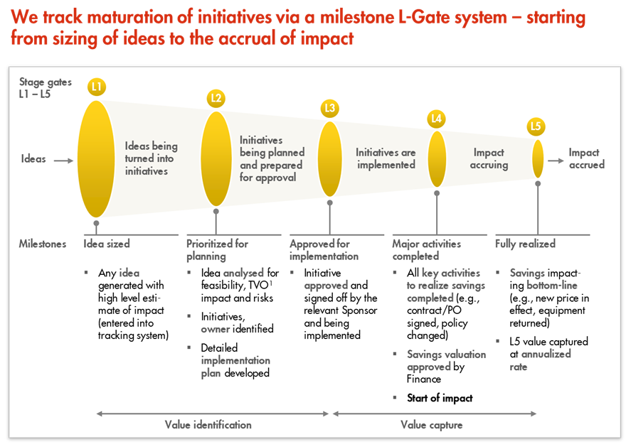
L1 – L5 Gates

